Slide 1
Business Intelligence Systems and Technologies
Session 2
Farha Imthiyaz,
BSc (Hons) in Software Engineering
(Solent University, UK),
MS in Data Science (Reading)
(NED University of Engineering & Technology, Karachi)

Slide 2

Road Map
What is Business Intelligence- vendors & non vendors
Some Terms
Case Study
What is a Business Intelligence System?
What is the role of BIS?
How did BIS evolve?
What is Database ?
What is DBMS?
What is ETL?
What is Staging Area?
What is Warehouse & Data Mart?
What is Data Cubes?
What is Data Mining?

Slide 3
What is Business Intelligence?

Slide 4
Business Intelligence
According to vendors:
A segment of information technology that comprises software systems that enable finding, storing, organising and supplying data; when incorporated into an information system, it enables company to utilise real-time analysis of information.
Information Technology Toolbox
www.ITToolbox.com

Slide 5
Business Intelligence
According to vendors:
software that enables business users to see and use large amounts of complex data (e.g. multidimensional analysis, query tools, data mining tools)
SDG Computing
www.sdgcomputing.com

Slide 6
Business Intelligence
According to vendors:
A category of applications and technologies for gathering, storing, analysing, reporting on and providing access to data to help enterprise users make better business decisions
Cognos (www.cognos.com)

Slide 7
Business Intelligence
According to vendors:
BI helps corporations transform their operational data into actionable information; helps meet query reporting and advanced analytical needs
MicroStrategy
www.microstrategy.com

Slide 8
Business Intelligence
According to non-vendors:
BI is processed information of interest to management about the present and future environment in which business is operating
Greene (1966)

Slide 9
Processed information vs. data
data - raw material that is composed of facts
intelligence information - information digested, analysed, and interpreted for the purpose of decision making
Management has crucial role in BI, determines
what will be in the domain of BI
what information if of interest or relevant to its decision
Company’s environment
Present environment (mostly for tactical intelligence)
Future environment (mostly for strategic intelligence)

Slide 10
Operational Intelligence
Affects operational levels of organization on daily, weekly, monthly basis
Tactical Intelligence
Affects a part of organization for a limited time (i.e., coming year) into the future
Strategic Intelligence
Affects the entire organization, or a major part of it for a long period of time (i.e., 2 - 5 years and beyond)

Slide 11
PURPOSE OF BI
Shift from reliance on short-term tactical decisions to better use of strategic intelligence in the decision-making process

Slide 12

Case Study
Analyze Habib Bank or Imtiaz Supermarket. List the Three Types of Users and Three Types of Decisions
Get into groups
Read and analyze the case study
Present the results
Habib Bank/ Imtiaz Supermarket
Operational Users
Tactical Users
Strategic Users
Operational Decisions
Tactical Decisions
Strategic Decisions

Slide 13
What is a Business Intelligence System?

Slide 14
Business Intelligence System (BIS)
BIS is an information system that provides BI to business decision makers at different levels of organization (operational, tactical, strategic levels)
BIS is an information system that turns selected data, information, and/or knowledge into desired intelligence for business gain (Thierauf, 2001)

Slide 15
What is the role of Business Intelligence System?

Slide 16
Role of BIS
Provide decision makers with the ability to understand (i.e., the intelligence to gain insights into) the relationships of presented facts in the form of data, information, and knowledge in order to guide action toward a desired actionable goal (Thierauf, 2001)

Slide 17
Role of BIS Cont..
Provide decision makers with timely data, information and knowledge for problem solving, and problem finding
Past : Decision making as Problem Solving activity
Reactive approach –use of appropriate management technologies to resolve current problems as they arise

Slide 18
Role of BIS Cont..
Current: Business intelligence activity as problem solving, as well as problem finding
Proactive, preventive approach – anticipating future company problems; looking for future opportunities

Slide 19
How did Business Intelligence Systems evolve?

Slide 20
Computer-based Support Systems Technologies
1950s Transaction Processing Systems (TPS)
1960s Management Information Systems (MIS)
1970s Office Automation Systems Decision Support Systems (DSS)
1980s DSS Expanded Commercial applications of Expert Systems Executive Information Systems (EIS)
1990s Group Support Systems Neural Computing Integrated, hybrid computer systems
Turban and Aronson (2001)

Slide 21
More BIS technologies
1990s Data warehouses
Enable decision makers to “pull” BI from a large centralised repository
created to support the information requirements of an organisation’s decision makers.
1990s OLAP (On-Line Analytical Processing) systems
Enable decision makers to build and work with analytical models easily and view the output in multiple dimensions
1990s Knowledge Management Systems (KMS)
Go beyond relationships found in information allowing decision makers to extract patterns, trends, correlations that underlie the inter workings of a company currently and over time

Slide 22
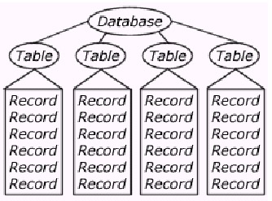
What is Database ?
A database is a collection of structured information or data that is organized so that it can be easily accessed, managed and updated.

Slide 23
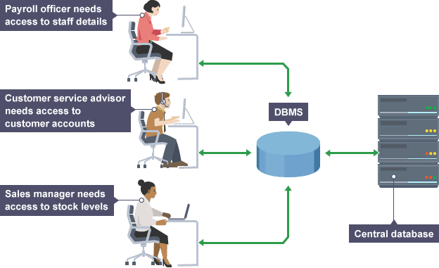
What is DBMS?
A database management system (DBMS) is system software for creating and managing databases.
The DBMS provides users and programmers with a systematic way to create, retrieve, update and manage data.

Slide 24
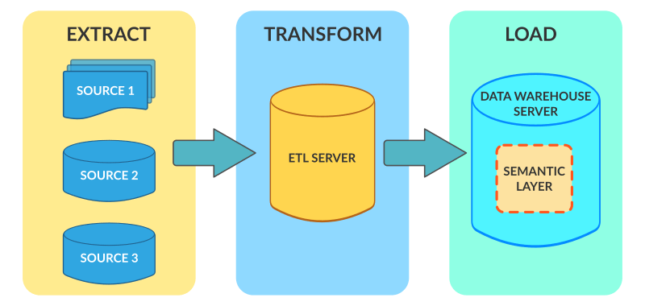
What is ETL?
ETL (Extract, Transform and Load) is a process in data warehousing responsible for pulling data out of the source systems and placing it into a data warehouse.

Slide 25
What is Staging Area?
Staging (data) A staging area, or landing zone, is an intermediate storage area used for data processing during the extract, transform and load (ETL) process. The data staging area sits between the data source(s) and the data target(s), which are often data warehouses, data marts, or other data repositories.

Slide 26
What is Warehouse & Data Mart?
A Data Warehouse is a large repository of data collected from different organizations or departments within a corporation. A data mart is an only subtype of a Data Warehouse. It is designed to meet the need of a certain user group. Usage.

Slide 27
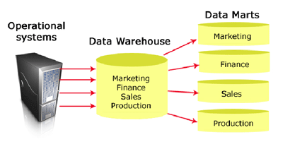
What is Warehouse & Data Mart?

Slide 28
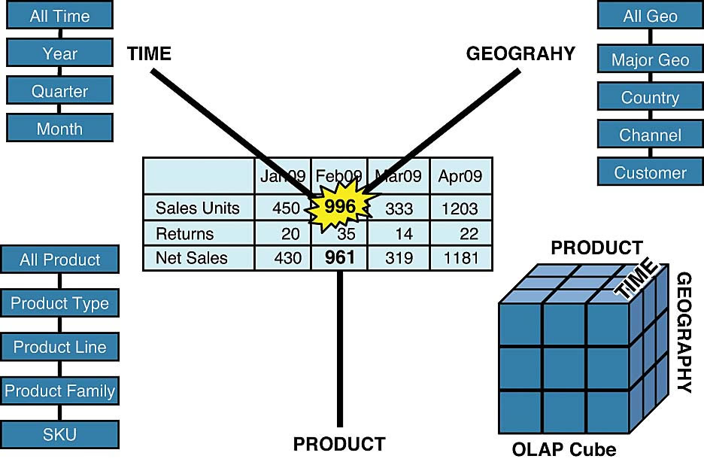
What is Data Cubes?
The cube is used to represent data along some measure of interest. Although called a "cube", it can be 2-dimensional, 3-dimensional, or higher-dimensional.

Slide 29
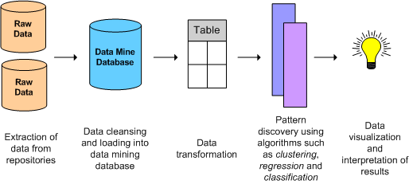
What is Data Mining?
Data mining is the process of sorting through large data sets to identify patterns and establish relationships to solve problems through data analysis. Data mining tools allow enterprises to predict future trends.

Slide 30
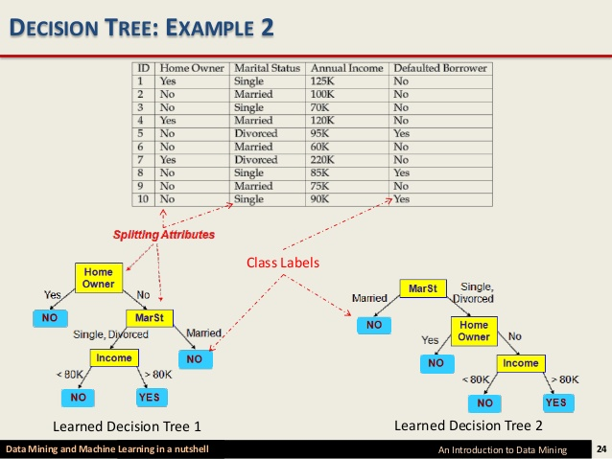
What is Data Mining?

Slide 31
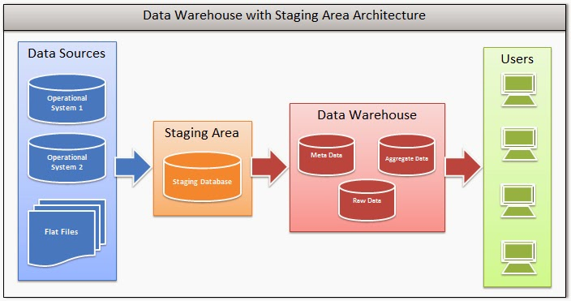

Slide 32
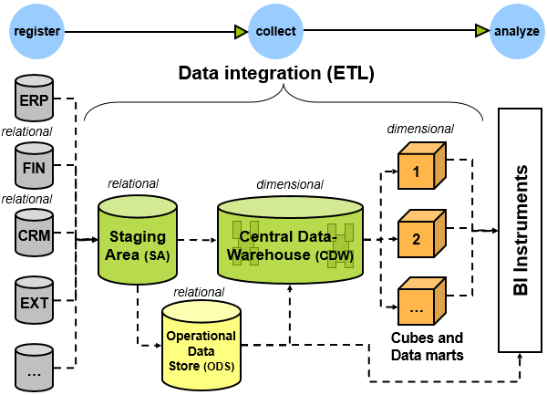

Slide 33
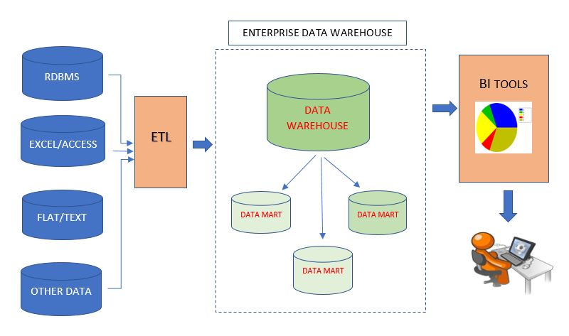

Slide 34
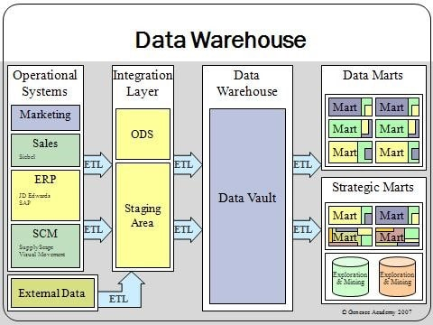

Slide 35


